Slide 1
Northern Finland Birth Cohort 1966
- material request and new data
Jouko Miettunen
Professor of Clinical Epidemiology
Center for Life Course Health Research, University of Oulu, Finland

Slide 2
How to apply NFBC Data for your research
NFBC 1966 AND 1986

Slide 3

NFBC web pages: http://www.oulu.fi/nfbc/
1. Go to the NFBC web- page
2. Get familiar with the data

Slide 4
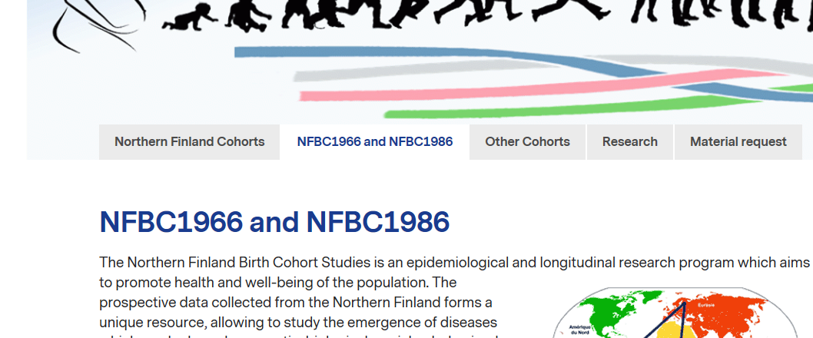
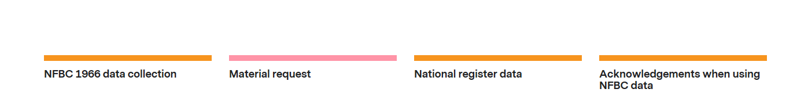
Scroll down the pages, click

Slide 5
Scroll down the pages, click

Slide 6
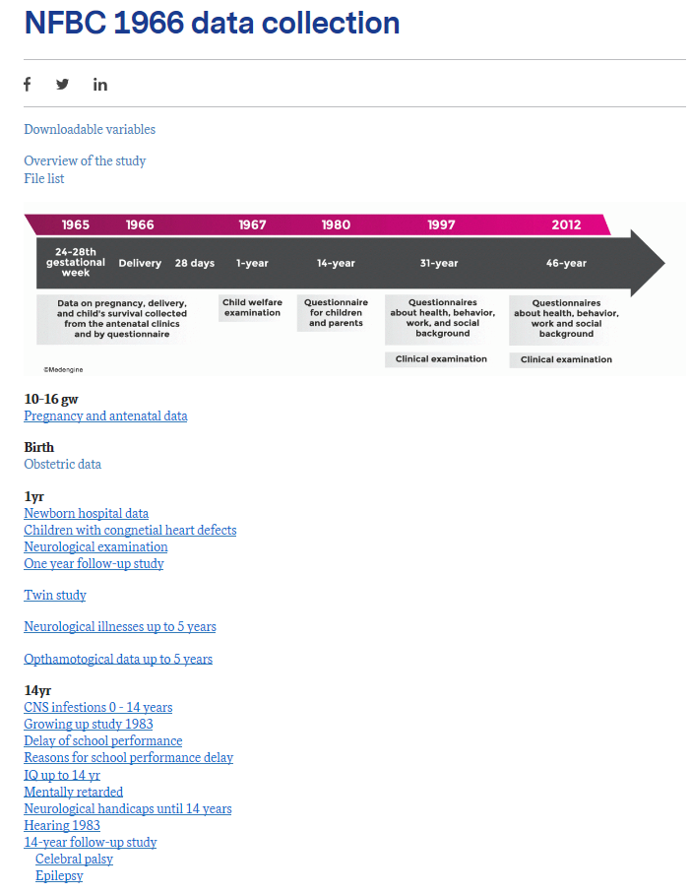
List of all variables can be loaded from here
Information from each follow-up or substudy can be found from links under the collection

Slide 7

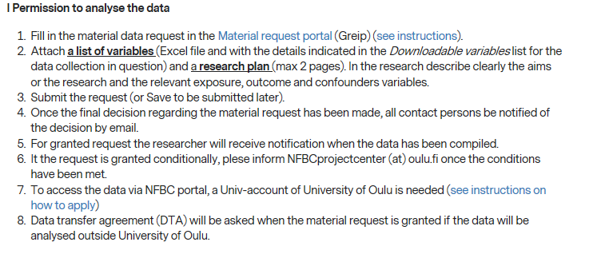
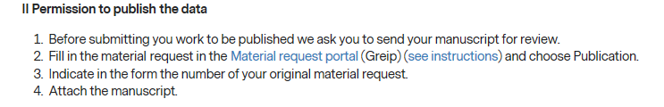
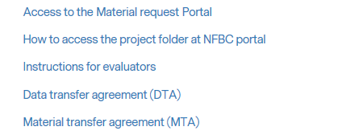
3. Instructions on how to apply you can find from here
Link to the material request form

Slide 8
How to fill…. Detailed instructions can be found here
Please note the two compulsory attachments and instructions on how to get the data access on the NFBC server,
and that if the data is used outside our university, certain contracts between institutes are needed.

Slide 9
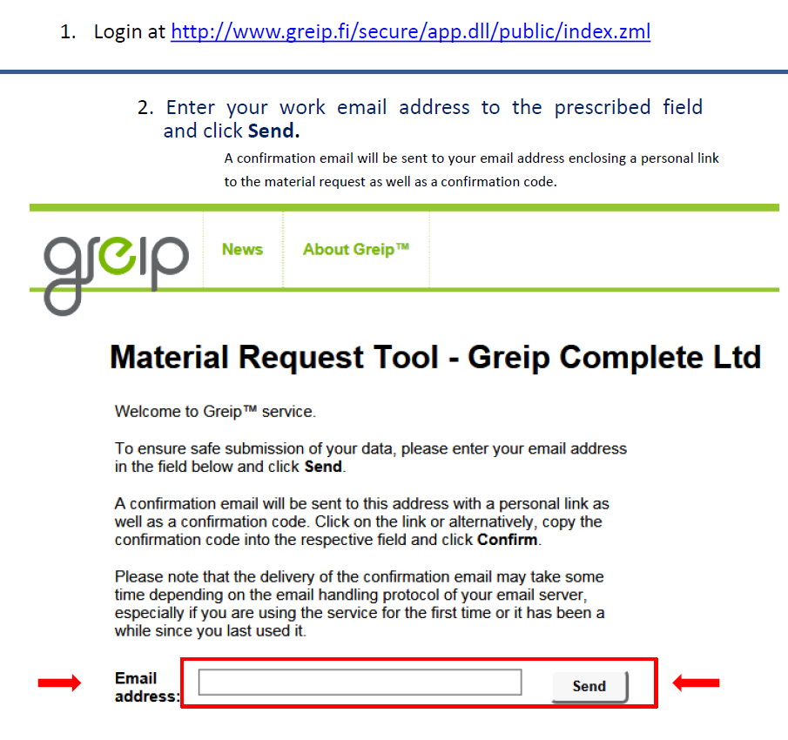
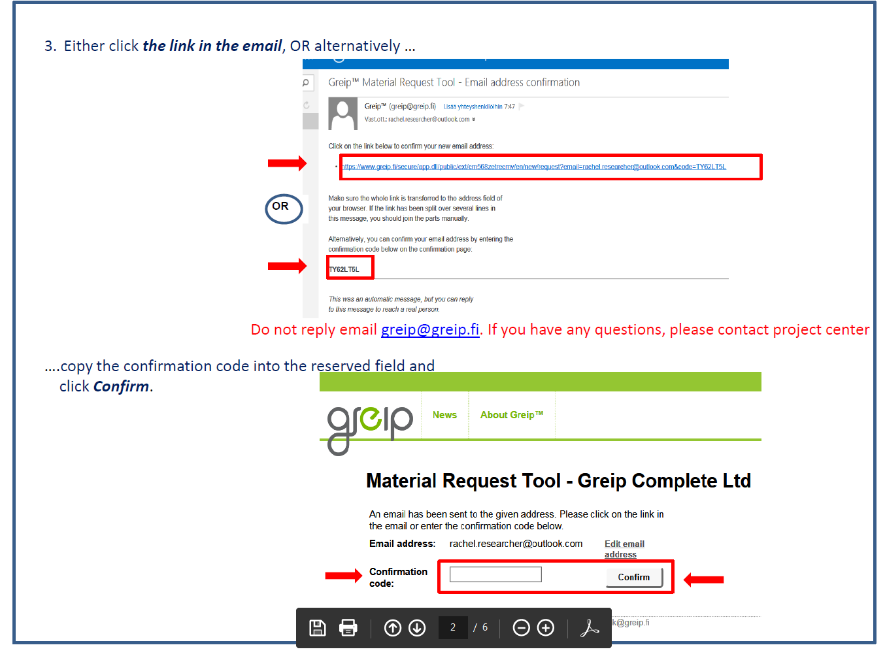
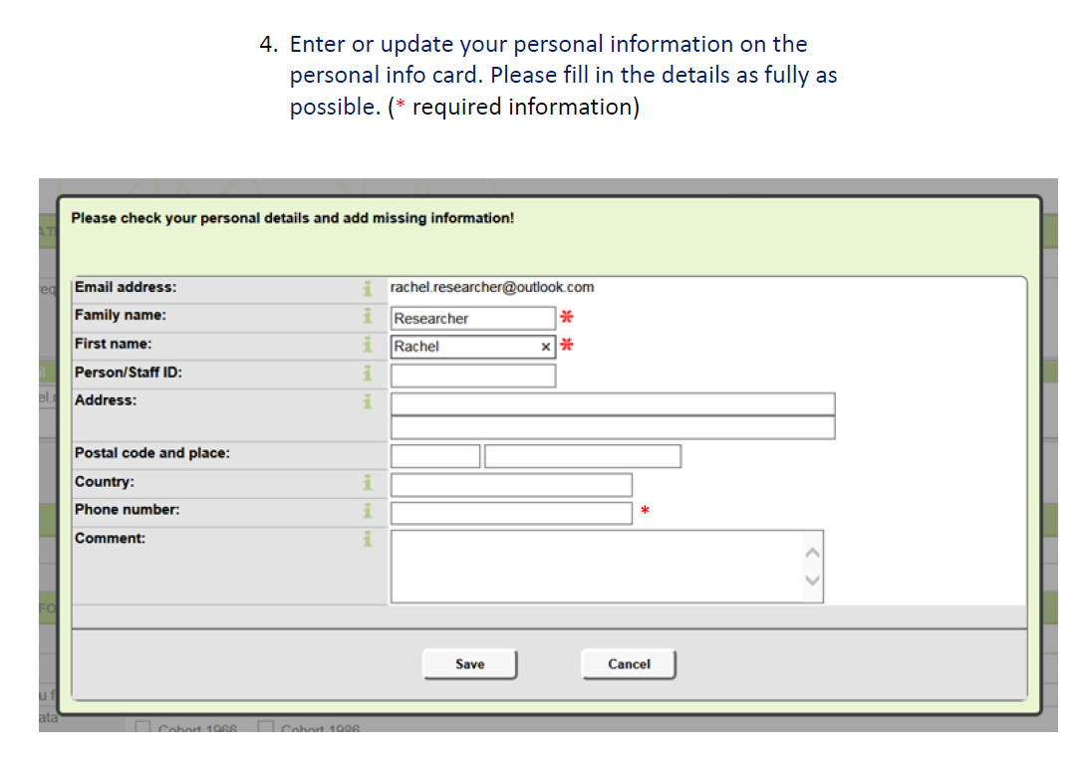
To start with Greip, login to the material request portal.

Slide 10
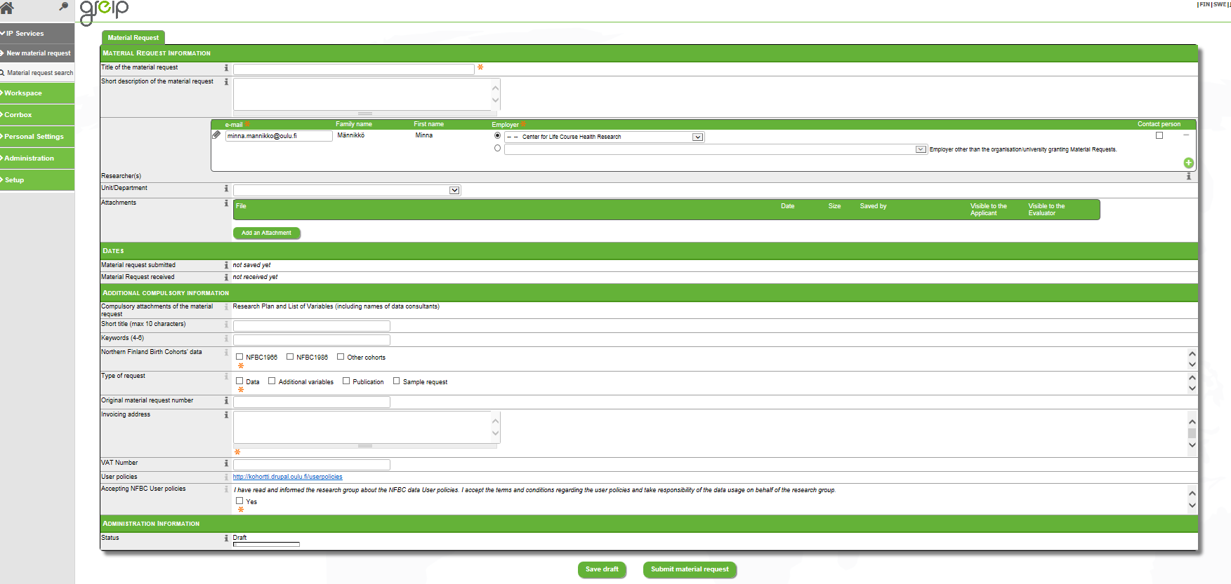
Material request form
i = what is required to each field
Add researchers
Notes:
Follow the instructions (webpage) and/or under i on the form.

Slide 11
Material requests
Are evaluated by the NFBC scientific committee
Evaluation time is 2 weeks.
Decision made by the research director based on committee’s comments (aim in 1 week).
Contact persons (indicated in the form) will receive an email from Greip.
If ”request granted with conditions below”, please inform the project center (NFBCprojectcenter@oulu.fi) once (and how) the conditions have been met. This is required before getting access to the data

Slide 12
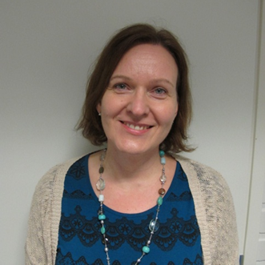

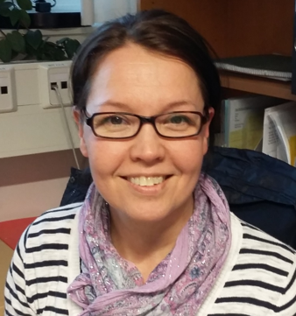

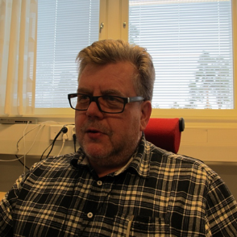

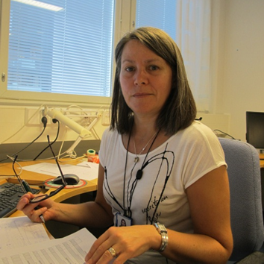





NFBC Project Center personnel
Minna Männikkö,
Research director
Tuula Ylitalo,
Project secretary
Anu Outinen-
Tuuponen,
Research nurse
Marja-Leena
Kytökangas Labo-
ratory technician
Arto Muhli, Data system manager
Marjo-Riitta Järvelin,
Scientific director
Eeva Vaaramo,
Statistician
Paula Pesonen,
Statistician
Tanja Nordström,
Statistician
Heli Lehtiniemi,
Statistician
Teemu Ahlholm,
IT-designer
Juha Auvinen,
Clinical adivisor
Need help, contact: NFBCprojectcenter@oulu.fi

Slide 13

Additional data permission issues
Permission usually in a couple of weeks, getting data may take some time, active collaboration helps ☺
Include a study plan and variable list
Data Transfer Agreement
European Commission Clauses agreement
Some registers (cases of death, occupation, education) not available for researchers outside Finland or European Union and most register require personal permission to use of the data – this can take some time!
MOST OF THE DATA IS AVAILABLE FOR EVERYONE!!!

Slide 14
NEW DATA
NFBC 1966

Slide 15
Northern Finland Birth Cohort 1966
12058 live-born children with expected date of birth 1.1.-31.12.1966
24-28th
gestational week
Delivery
28 days
1-year
14-year
24-year
31-year
46-year
Data of pregnancy and delivery and children's survival collected by the antenatal clinics and by questionnaire
Child welfare examination
Questionnaire for children and parents
Questionnaires for young men health and behavior
Questionnaires about health, behavior, work and social background, and clinical examination
Questionnaires about health, behavior, work and social background, and clinical examination
Employment, unemployment and pensions (Register of Finnish Centre for Pensions)
Hospitalizations and diagnoses (Hospital discharge register, inpatients/outpatients)
Medications and sick leaves (Social Insurance Institution of Finland, KELA)
Investments (EuroClear -register), earnings
Infectious diseases (Finnish register of infections)
Cancers (Finnish register of cancers)
Death and death causes (Finnish register of deaths)
1965
1966
1967
1980
1990
1997
2012
By midwives at maternity health centers
By self-administered questionnaires
From hospital records and maternity health cards
Clinical examinations, biological samples

Slide 16
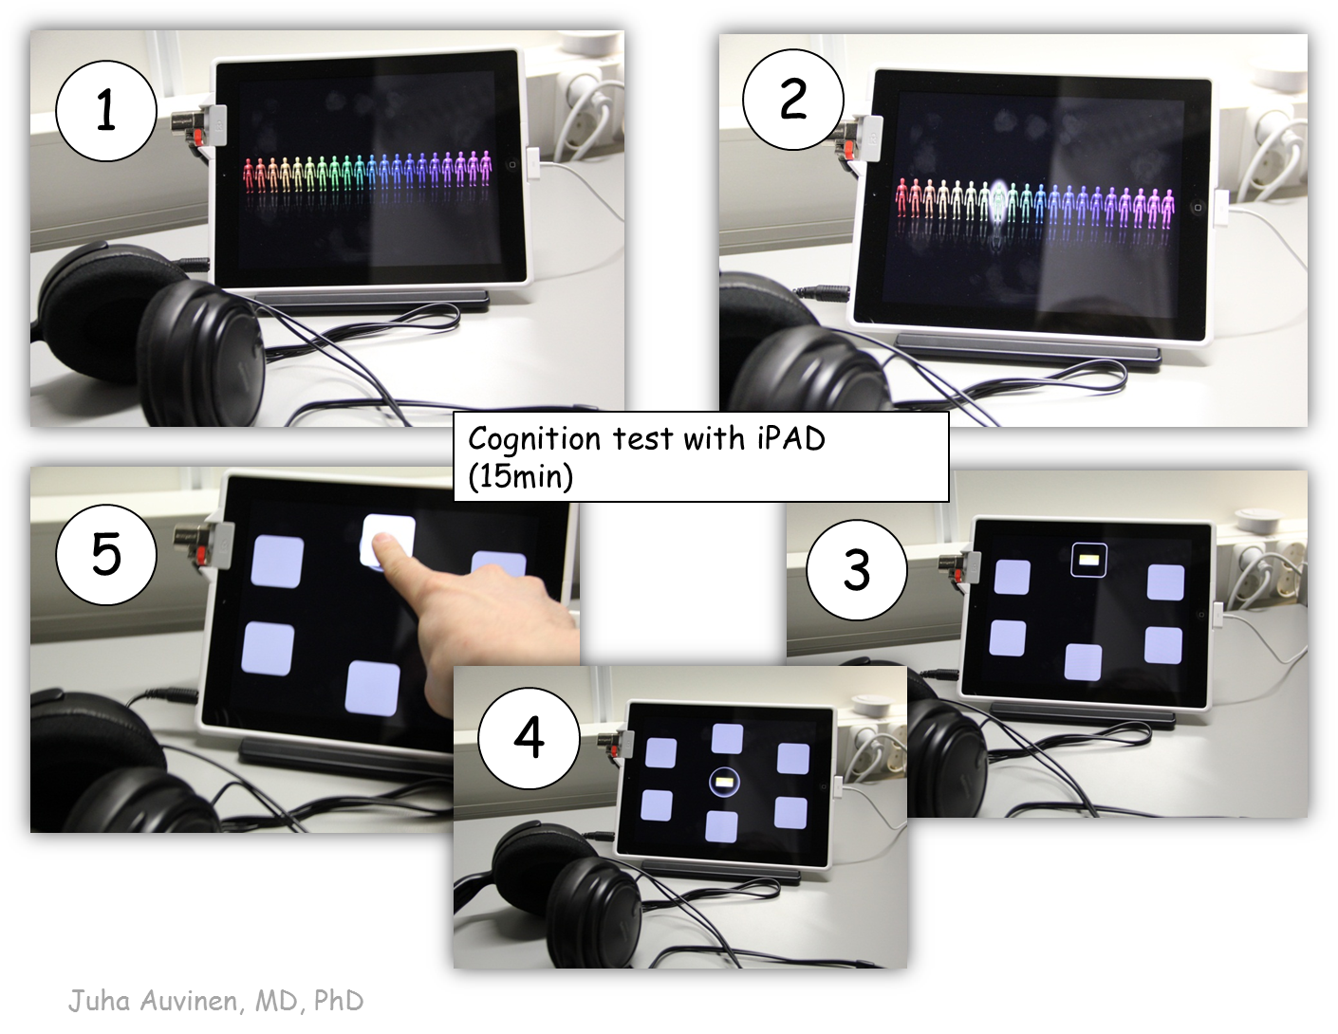
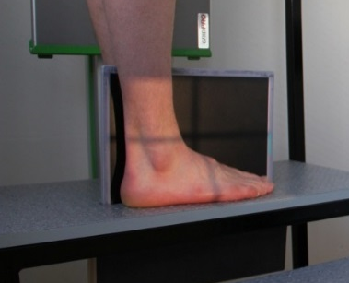
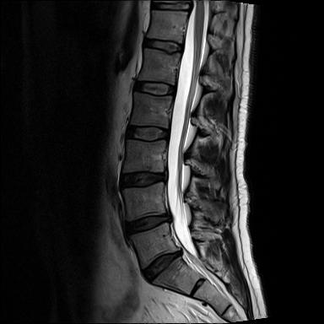
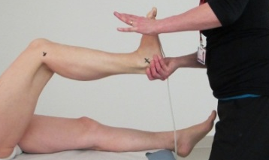
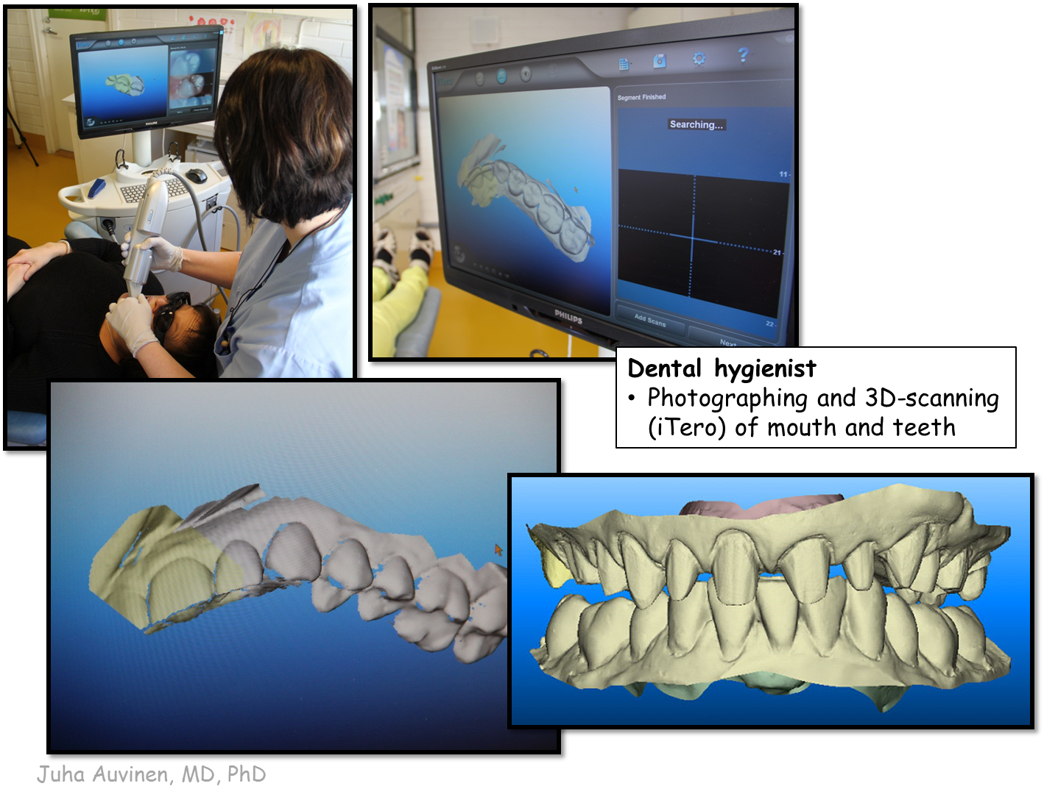



Northern Finland Birth Cohort 1966:
Data collection at 45-46 years in 2012 - 2014
Health, behaviour, work and lifestyle
Diet, FFQ
Fittness/activity (objective)
Weight, height, bioimpedance
Cognitive, sensory, psychological/mental:
Paired Associative Learning Test (PAL) using iPAD
Vision/ eye tests
[Hearing]
Musculoskeletal/dental:
Muscle strength, spinal column position/posture (objective measure)
Measures of osteoporosis
Dental disorders
Notes:
Questionaires:
Postal:
Backgroud, lifestyle & health
Economy, work & mental resources
During the examination day:
Dental questionaire
Additional questionaire (täydentävät kysymykset)
After clinical:
Opinions and experiences

Slide 17
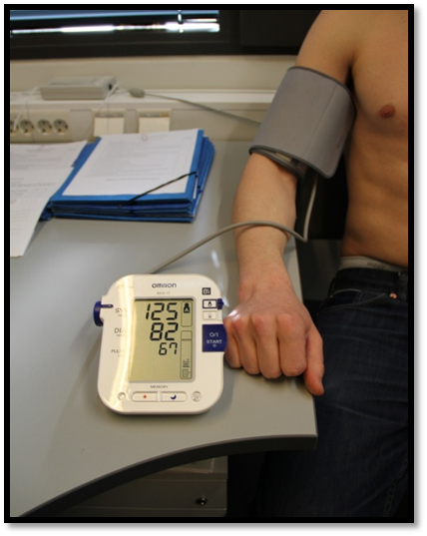
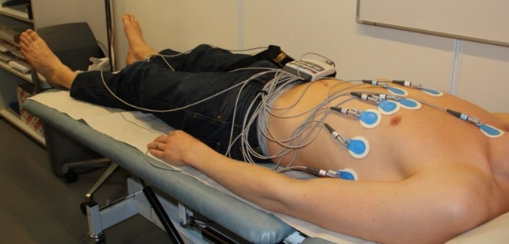
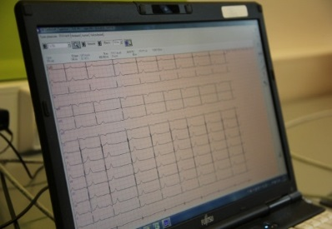
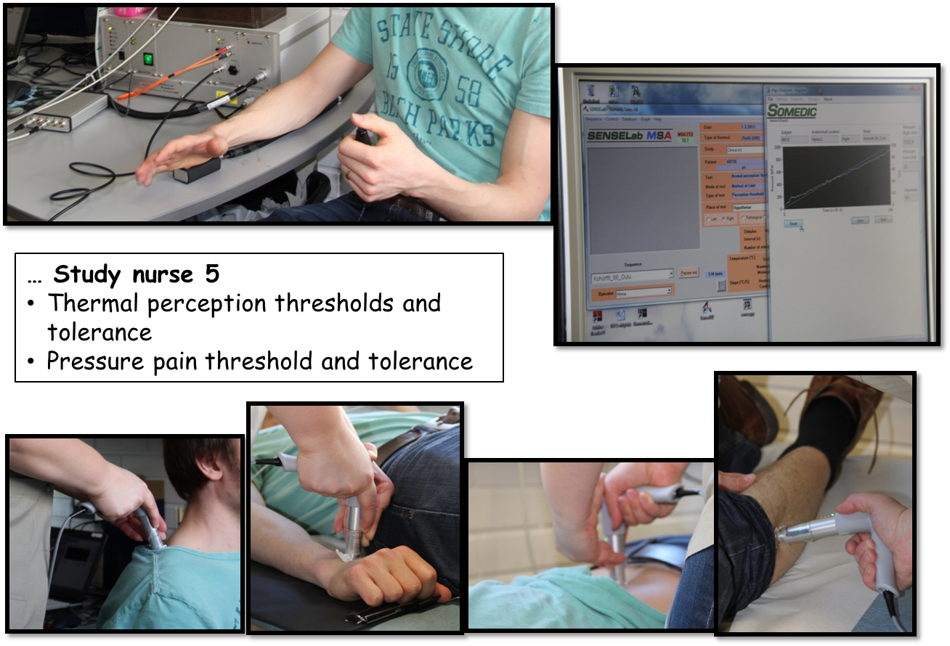
Northern Finland Birth Cohort 1966:
Data collection at 45-46 years in 2012 - 2014
Cardiovascular
BP (+central), heart and carotid artery ultrasound, ECG
  Respiratory, lung function, atopy:
  Spirometry, skin prick tests
  Gastro-intestinal:
  Kidney and liver function
  Chronic bowel inflammatory diseases
Urinary tract, reproductive:
Menopausal symptoms
Incontinence, prostatic symptoms
Blood and other samples: Measures of metabolic health, DNA, RNA, cells, urine, stool, saliva
Notes:
Questionaires:
Postal:
Backgroud, lifestyle & health
Economy, work & mental resources
During the examination day:
Dental questionaire
Additional questionaire (täydentävät kysymykset)
After clinical:
Opinions and experiences

Slide 18
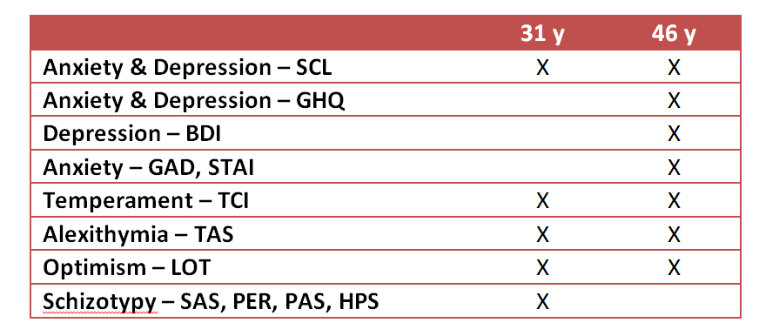
NFBC 1966 - psychiatric scales

Slide 19
Data from different national registers
Care Register for Health Care (inpatients, outpatients)
Medications and sick leaves (Social Insurance Institution)
Cancers, Infection diseases (specific registers)
Employment, unemployment and disability pensions (Centre for Pensions)
Investments (EuroClear -register), Earnings
Marriages, born children, addresses, etc. (Population register)
Causes of death (Finnish register of deaths; can be used only in Finland)
Occupation, education (Statistics Finland; can be used only in Finland)
Available death and hospital diagnoses also for parents
THESE CAN BE USED FOR CASE FINDING, AS EXPOSURE, AS OUTCOME ETC.

Slide 20
Care Register for Health Care
One of the oldest individual level hospital discharge registers covering the whole country (previously known as Hospital Discharge Register)
Contains nationwide linkable data on all inpatient hospital discharges with personal identification code since 1969
Outpatient visits in hospitals since 1998
Outpatient primary care visits since 2011
Diagnoses were recorded using
  ICD-8 during 1969−1986
  ICD-9 during 1987−1995
  ICD-10 since 1996
Intensively used for research purposes
For statistical and research purposes the quality of FHDR has been shown to be at least satisfactory
Miettunen J, et al. Use of register data for psychiatric epidemiology in the Nordic countries. In: Textbook in Psychiatric Epidemiology, 3rd edition, Eds. Tsuang M, Tohen M, Jones P, pp. 117-31. Wiley-Blackwell, 2011.
Sund R. Quality of the Finnish Hospital Discharge Register: a systematic review. Scand. J. Public Health 2012; 40:505-15.
Notes:
There is systematic internal quality control for the register data. Certain logical errors are algorithmically checked and the data
collection clerk reviews the contents of the data, compares the changes with earlier years and asks hospitals to correct detected errors
Completeness and accuracy in the register seem to vary from satisfactory to very good in the register

Slide 21
NFBC – hierarchical register diagnoses
Registers: coverage | NFBC 1966 | NFBC 1986
Care Register for Health Care: inpatient care until 2015 | X | X
Finnish outpatient registers: specialized care 1998-2015 | X | X
Finnish outpatient registers: primary care 2011-2015 | X | X
Social Insurance Institution: reimbursable medicines until 2005 | X | X
Finnish Center for Pensions: disability pensions until 2016 | X | X
Social Insurance Institution registers: disability pensions until 2000 | X
Social Insurance Institution registers: sick days until 1999 | X

Slide 22
NFBC – hierarchical register diagnoses
 | NFBC 1966 |  | NFBC 1986
 | n | % | n | %
Schizophrenia | 231 | 1.9 | 74 | 0.8
Psychotic bipolar | 29 | 0.2 | 19 | 0.2
Psychotic depression | 73 | 0.6 | 31 | 0.3
Other psychoses | 110 | 0.9 | 98 | 1.0
All psychoses | 443 | 3.6 | 231 | 1.9
Nonpsychotic bipolar | 79 | 0.6 | 47 | 0.5
Nonpsychotic depression | 714 | 5.8 | 702 | 7.4
Other nonpsychotic dis. | 1032 | 8.4 | 981 | 10.3
Any psychiatric disorder | 2268 | 18.5 | 1961 | 20.6
No psychiatric disorder | 9963 | 81.5 | 7527 | 79.4

Slide 23
NFBC1966 – new data from Social Insurance Institution
Data available only for those who participated at the 46-year follow-up (n=7071)
All bought medications from pharmacies 1997-2016
  Selected ATC codes, e.g. all psychiatric medications
  ATC code, cost, for some (10%) also information regarding number of tablets and dose
  e.g. 262 individuals using antipsychotics, 1128 using benzodiazepines, 851 using SSRI antidepressants in 2006-2012
Sick days 2000-2016
  Diagnoses (sometimes missing), days
  e.g. 60 individuals with psychotic diagnoses
Disability pensions 2000-2016
  Diagnoses (sometimes missing), start date, possible end date
  Own register for negative decisions
Reimbursable medication rights 2000-2016
  Diagnoses (sometimes missing), start date, possible end date

Slide 24
Geographical data
Coordinate based migration history
Postcode, grid (250x250m) or buffer based data

Slide 25
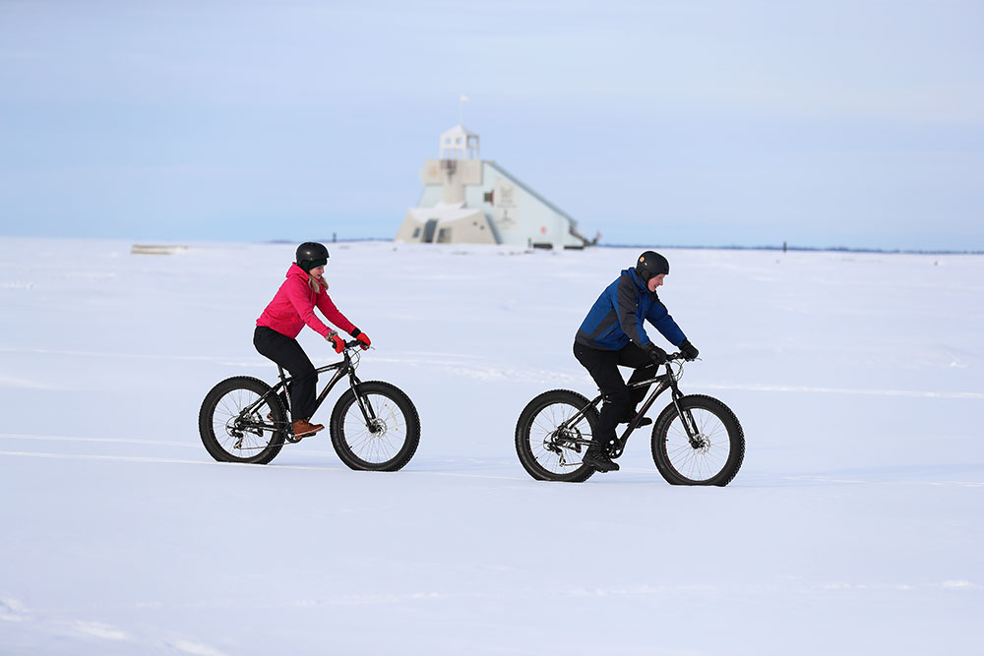
THANK YOU!
CONTACT: jouko.miettunen@oulu.fi www.oulu.fi/nfbc

